Slide 1

C Programming Introduction week 13: Strings
Lecturer : Cao Tuan Dung
Dept of Software Engineering
Hanoi University of Technology
For HEDSPI Project

Slide 2
Strings
An array of characters
Used to store text
Another way to initialize:
char str[] = "Text";

Slide 3
The terminator
….
….
….
's'
'H'
'H'
'#'
'e'
'e'
' '
'l'
'l'
'f'
'l'
'l'
'd'
'o'
'o'
'y'
' '
' '
'4'
'w'
'w'
'7'
'o'
'o'
'$'
'r'
'r'
'_'
'l'
'l'
'e'
'd'
'd'
'g'
'g'
'\0'
'd'
'd'
'd'
'.'
'.'
'.'
'p'
'p'
'p'
'v'
'v'
'v'
….
….
….
str
str
Terminator

Slide 4
The Terminator
Strings terminate with NULL character, signed by '\0' (ascii code 0)
This is a convention used to know where the string ends
It means that in order to hold a string of N characters we need an array of length N + 1
So the previous initialization is equivalent to
char str[] = {'b', 'l', 'a', 'b', 'l', 'a', '\0'};

Slide 5
String library
Like in the case of stdio.h and math.h, we have a special library for handling strings
We should #include <string.h>

Slide 6
String library
Functions:
  strlen(const char s[])
  returns the length of s
  strcmp(const char s1[],
  const char s2[])
  compares s1 with s2
  strcpy(char s1[],
  const char s2[])
  copies to contents of s2 to s1
  and more…

Slide 7
Example
#include <stdio.h>
#include <string.h>
int main()
{
char s1[ 20 ] = "Happy ";
char s2[] = "New Year ";
char s3[ 40 ] = "";
printf( "s1 = %s\ns2 = %s\n", s1, s2 );
printf( "strcat( s1, s2 ) = %s\n", strcat( s1, s2 ) );
printf( "strncat( s3, s1, 6 ) = %s\n", strncat( s3, s1, 6 ) );
printf( "strcat( s3, s1 ) = %s\n", strcat( s3, s1 ) );
return 0;
}
s1 = Happy
s2 = New Year
strcat( s1, s2 ) = Happy New Year
strncat( s3, s1, 6 ) = Happy
strcat( s3, s1 ) = Happy Happy New Year

Slide 8
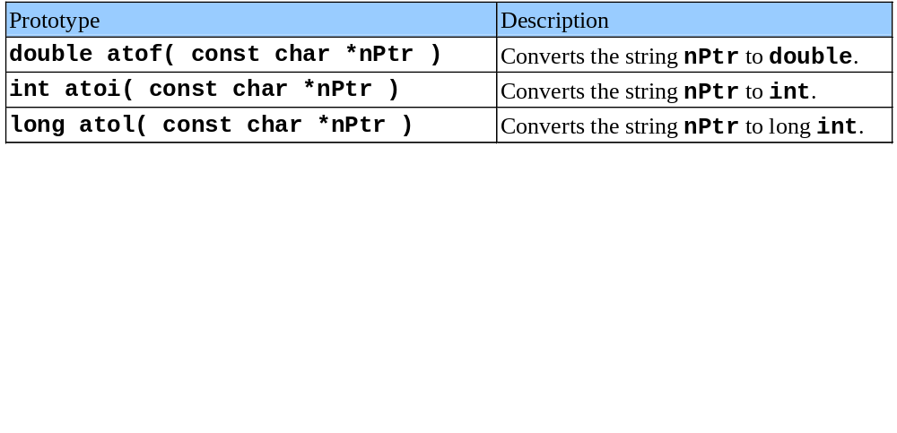
String Conversion Functions
Conversion functions
  In <stdlib.h> (general utilities library)
Convert strings of digits to integer and floating-point values

Slide 9
Character Analysis and Conversion
Functions (ctype.h) | Description
isalpha | Check if the argument is a letter
isdigit | Check if the argument is one of the ten digits
isspace | Check if argument is a space, newline or tab.
tolower | Converts the lowercase letters in the argument to upper case letters.

Slide 10
String conversion function

Slide 11
Arrays of Strings
An array of strings is a two-dimensional array of characters in which each row is one string.
  char names[People][Length];
  char month[5][10] = {“January”, “February”, “March”, “April”, “May”};

Slide 12
Exercise 13.1
Write a program that inputs a line of text, counts the number of blanks by using a function, and displays the number of blanks.

Slide 13
Solution
#include <stdio.h>
#include <string.h>
void spacecounter(char []); // Function prototype
void main(void)
{
char line[81];
printf("Enter a line of text:\n");
gets(line);
printf("Blanc character occurs for: %d time in the line.\n", spacecounter(line));
}

Slide 14
Solution
int spacecounter(char inputline[])
{
int i = 0;
int count = 0;
while (inputline[i] != '\0') {
if (inputline[i] == ' ')
count++;
}
i++;
}
return count
}

Slide 15
Exercise 13.2
write a function that:
  gets a string and two chars
  the functions scans the string and replaces every occurrence of the first char with the second one.
write a program to test the above function
  the program should read a string from the user (no spaces) and two characters, then call the function with the input, and print the result.
example
  input: “papa”, ‘p’, ‘m’
  output: “mama”

Slide 16
Solution (function)
void replace(char str[], char replace_what,
char replace_with)
{
int i;
for (i = 0; str[i] != '\0'; ++i)
{
if (str[i] == replace_what)
str[i] = replace_with;
}
}

Slide 17
Solution (main program)
#define STRING_LEN 100
int main(void)
{
char str[STRING_LEN + 1];
char replace_what, replace_with;
printf("Please enter a string (no spaces)\n");
scanf("%100s", str);
printf("Letter to replace: ");
scanf(" %c", &replace_what);
printf("Letter to replace with: ");
scanf(" %c", &replace_with);
replace(str, replace_what, replace_with);
printf("The result: %s\n", str);
return 0;
}

Slide 18
Exercise 13.3
Write a program that tests a customer number to determine whether it is in the proper format(LLLNNNN with LLL are letters and NNNN are numbers).

Slide 19
Solution: testNum function
bool testNum(char custNum[])
{
// Test the first three characters for alphabetic letters
for (int count = 0; count < 3; count++)
{
if (!isalpha(custNum[count]))
return false;
}
// Test the last 4 characters for numeric digits
for (int count = 3; count < 7; count++)
{
if (!isdigit(custNum[count]))
return false;
}
return true;
}

Slide 20
Solution: main program
#include <stdio.h>
#include <ctype.h>
bool testNum(char []);
void main(void)
{
char customer[8];
printf("Enter a customer number with exact 7 characters in the form LLLNNNN\n";
printf("LLL = letters and NNNN = numbers): ";
scanf("%s",customer);
if (testNum(customer))
printf("That's a valid customer number.\n";
else
{
printf("That is not the proper format of the customer number.\nHere is an example: ABC1234\n");
}
}

Slide 21
Exercise 13.3
Write your own replacement for the standard strcpy() that comes with C without using string.h

Slide 22
Solution
char *my_strcpy(char *destination, char *source)
{
char *p = destination;
while (*source != '\0')
{
*p++ = *source++;
}
*p = '\0';
return destination;
}

Slide 23
Exercise 13.4
Write a program asks the user to enter his or her first and last names, separated by a space. Then print out the first name.
The program shoud use a function which cuts off the last name off the string in parameter.

Slide 24
Solution
#include <stdio.h>
#include <string.h>
void nameSlice(char []); // Function prototype
void main(void)
{
char name[41];
printf("Enter your first and last names, separated by a space:\n");
gets(name);
nameSlice(name);
printf("Your first name is: %s\n", name);
}

Slide 25
Solution
// This function accepts a character array as its
// argument. It scans the array looking
// for a space. When it finds one, it replaces it
// with a null terminator.
void nameSlice(char userName[])
{
int count = 0;
while (userName[count] != ' ' && userName[count] != '\0')
count++;
if (userName[count] == ' ')
userName[count] = '\0';
}

Slide 26
Exercise 13.5
Write the function strend(s,t), which returns 1 if the string t occurs at the end of the string s, and zero otherwise.

Slide 27
Solution: strend function
#include <string.h>
int strend(char *s, char *t)
{
int Result = 0;
int s_length = 0;
int t_length = 0;
/* get the lengths of the strings */
s_length = strlen(s);
t_length = strlen(t);
if(t_length <= s_length) {
/* advance the s pointer to where the string t would have to start in string s */
s += s_length - t_length;
/* and make the compare using strcmp */
if(0 == strcmp(s, t)) {
Result = 1;
}
}
return Result;
}

Slide 28
Solution: main program
#include <stdio.h>
int main(void)
{
char *s1 = "some really long string.";
char *s2 = "ng.";
char *s3 = "ng";
if(strend(s1, s2)) {
printf("The string (%s) has (%s) at the end.\n", s1, s2);
} else {
printf("The string (%s) doesn't have (%s) at the end.\n", s1, s2);
}
if(strend(s1, s3)){
printf("The string (%s) has (%s) at the end.\n", s1, s3);
}
else {
printf("The string (%s) doesn't have (%s) at the end.\n", s1, s3);
}
return 0;
}

Slide 29
Exercise 13.6: Using strstr
A list of product number and description of shop is:
"TV127 31 inch Television",
"CD057 CD Player",
"TA877 Answering Machine",
"CS409 Car Stereo",
"PC655 Personal Computer"
Store this list in an array of string and write a program allowing user to lookup a product description by entering all or part of its product number.

Slide 30
Solution
#include <stdio.h>
#include <string.h> // For strstr
void main(void)
{
char prods[5][27] = {"TV127 31 inch Television",
"CD057 CD Player",
"TA877 Answering Machine",
"CS409 Car Stereo",
"PC655 Personal Computer"};
char lookUp[27], *strPtr = NULL;
int index;
printf("\tProduct Database\n\n");
printf("Enter a product number to search for: ");
scanf("%s",lookUp);

Slide 31
Solution
for (index = 0; index < 5; index++)
{
strPtr = strstr(prods[index], lookUp);
if (strPtr != NULL)
break;
}
if (strPtr == NULL)
printf("No matching product was found.\n");
else
printf("%s\n", prods[index]);
}

Slide 32
Exercise 13.7
Write a program that accepts a string from the user
and replaces all punctuation signs (,.;:!?) with spaces

Slide 33
Solution (str_any.c)
char* str_any(char* str1, char* str2)
{
while (*str1 != '\0')
{
if (strchr(str2, *str1) != NULL) {
return str1;
}
++str1;
}
return NULL;
}

Slide 34
Solution
int main(void)
{
char* punc = ".,;:!?";
char s[MAX_LENGTH + 1];
char *p;
printf("Please enter a line of text\n");
scanf("%100s", s);
for (p = str_any(s, punc);
p != NULL;
p = str_any(p + 1, punc)) {
*p = ' ';
}
printf("Resulting string is:\n%s\n", s);
return 0;
}

